Slide 1
Lab Exercise I

Slide 2
EXERCISE 1
difference
z=x-17
x>17 ?
yes
print(d=2 *z)
print (z =x-17)
end

Slide 3
EXERCISE 2
sum
A=x+y+z
x==y==z?
yes
no
print(3*A)
print (A)
end

Slide 4
EXERCISE 3
start
input value for x, input value for y
x==y or x+y=5 or x-y=5?
false
print(true)
print(false)
end
end

Slide 5
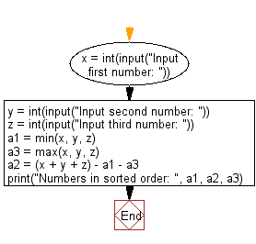
EXERCISE 4

Slide 6
EXERCISE 5
sum of cubes
n-=1
total=0
n>0 ?
yes
no
total+=n*n*n,n-=1
return total
print(“sum of cube “, sum of cube(inputted number))
end

